Slide 1
Table of Contents
Variables
Introduction to Data Types
Strings
Numeric Types
Boolean
Type Conversion
Notes:
what i am gonna cover are shown on the screen. at the end of this lecture you will be able to work with basic data types which are strings, numerics and booleans. and you will be able to convert these types into each other. let’s begin

Slide 2

Variables
Notes:
Let’s start with some reviews

Slide 3
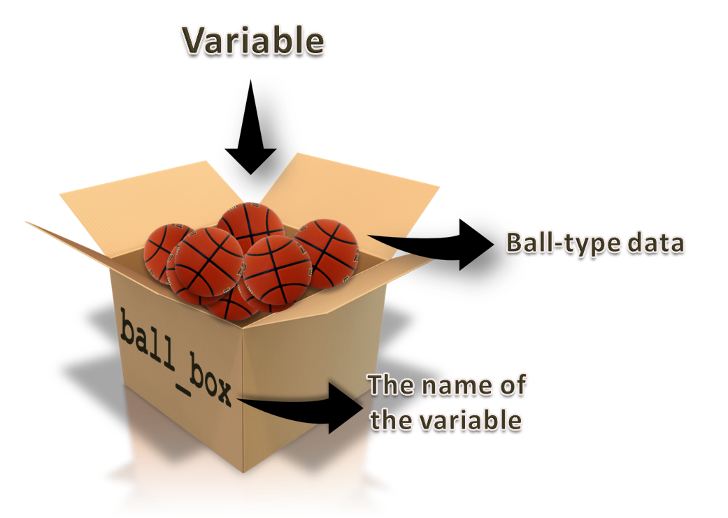
Variables : refreshing
Notes:
What I stated before is that : Variable is a location designated where a value can be stored and accessed later. this point is important. you store some value and then it is accessible later. Imagine a box where you store something. That's a variable. in a short description.

Slide 4

Naming Variables

Slide 5
Table of Contents
General Description
Conventional (PEP 8) Naming Rules

Slide 6
General Description

Slide 7



General Description
variable_name
Notes:
As you know, each variable has a unique name that distinguishes it from others. Giving a good name to a variable may not be as simple as it sounds.
A Python variable is a reserved memory location to store values. In other words, a variable gives data to the computer for processing. We will discuss variables in detail in the next lessons.
Remember, a nice and meaningful naming of variables is a skill that can be gained over time. Of course, you also need to be familiar with PEP 8 traditional rules.
Expert programmers care much for naming the variables well to make their codes easy to understand. It is important because programmers spend a lot of time reading and understanding code written by other programmers.
The convention of naming is optional. You can use any names you like but it is useful to follow the convention so that someone (including you) knows what you have written.

Slide 8

Con_PEP_N_Rl
I didn't understand anything.
Notes:
what do you think this could be
Con_PEP_N_Rl

Slide 9
Con_PEP_N_Rl
Conventional (PEP 8) Naming Rules
bad example of naming a variable

Slide 10
Conventional (PEP 8) Naming Rules
Some basic naming conventions
Choose lowercase words and use underscore to split the words
variable = 3.14
var_one = 'something'
Notes:
Now let's learn how to choose good names for our variables in accordance with PEP 8 rules:
variable = 3.14
var_one = 'something'

Slide 11
Conventional (PEP 8) Naming Rules
Some basic naming conventions
Do not use 'l' (lowercase letter “L”) as single character variable.
l = 3.14 # This is lowercase letter el I = 3.14 # This is uppercase letter eye
1 = 'something wrong' # This is number one.
Notes:
In some fonts, these characters are indistinguishable from the numerals one and zero. If you want to use 'l', use 'L' instead.
l = 3.14 # This is lowercase letter el I = 3.14 # This is uppercase letter eye
1 = 'something wrong' # This is number one.

Slide 12
Conventional (PEP 8) Naming Rules
Some basic naming conventions
Do not use 'O' (uppercase letter “O”) as single character variable.
time_O = '3.14' # This is uppercase letter “O” time_0 = '3.14' # This is number zero
Notes:
time_O = '3.14' # This is uppercase letter “O” time_0 = '3.14' # This is number zero

Slide 13
Some Important PEP 8 Rules
Some basic naming conventions
The name of the variable must be legible, meaningful and relevant to the type of value
Good
Bad
students = ...
s = ... or st = ...
# Big Data
big_data = ...
# Big Data
b_dt = ...
# Average income of February
avg_income_feb = ...
# Average income of February
average_income_february = ..
Notes:
practices of good naming to variables. discuss in the class:
1- The value of variable to be named is : ‘the list of prime numbers’
good samples :
prime_list = [1, 2, 3, 5, 7]
prime_no = [1, 2, 3, 5, 7]
list_prime = [1, 2, 3, 5, 7]
num_prime = [1, 2, 3, 5, 7]
2- The value of variable to be named is : ‘amount of rotten fruits’.
good samples :
rotten_fruit_amount = 33 lb.
amnt_fruit_rotten = 33 lb.
3- The value of variable to be named is : ‘the list of mathematics exam scores’ .
good samples :
math_score = [77, 67, 88]
score_math = [77, 67, 88]

Slide 14
Some Important PEP 8 Rules
Some basic naming conventions (reserved words)
Do not use specific Python keywords such as :
False class finally is return
None continue for lambda try
True def from nonlocal while
and del global not with
as elif if or yield
assert else import pass break
except in raise

Slide 15
Pythonic Rules
💡Examine these samples carefully
2me 👉🏻 😔 data4me 👉🏻 😀
Big boss 👉🏻 😔 first! 👉🏻 😔
big-boss 👉🏻 😔 xy#@!v 👉🏻 😔
last_name👉🏻 😀 $price 👉🏻 😔

Slide 16
Naming Variable
amount of rotten fruits
the list of prime numbers
the list of mathematics exam scores
What can be the Name of these sentences in terms of variables.

Slide 17
Naming variable
amount of rotten fruits
Good samples :
rotten_fruits = 33 # kg.
amount_rotten_fruits = 33 # kg.
Notes:
practices of good naming to variables. discuss in the class:
1- The value of variable to be named is : ‘the list of prime numbers’
good samples :
prime_list = [1, 2, 3, 5, 7]
prime_no = [1, 2, 3, 5, 7]
list_prime = [1, 2, 3, 5, 7]
num_prime = [1, 2, 3, 5, 7]
2- The value of variable to be named is : ‘amount of rotten fruits’.
good samples :
rotten_fruit_amount = 33 lb.
amnt_fruit_rotten = 33 lb.
3- The value of variable to be named is : ‘the list of mathematics exam scores’ .
good samples :
math_score = [77, 67, 88]
score_math = [77, 67, 88]

Slide 18
Naming variable
the list of prime numbers
Good samples :
prime_list
prime_no
list_prime
num_prime
Notes:
practices of good naming to variables. discuss in the class:
1- The value of variable to be named is : ‘the list of prime numbers’
good samples :
prime_list = [1, 2, 3, 5, 7]
prime_no = [1, 2, 3, 5, 7]
list_prime = [1, 2, 3, 5, 7]
num_prime = [1, 2, 3, 5, 7]
2- The value of variable to be named is : ‘amount of rotten fruits’.
good samples :
rotten_fruit_amount = 33 lb.
amnt_fruit_rotten = 33 lb.
3- The value of variable to be named is : ‘the list of mathematics exam scores’ .
good samples :
math_score = [77, 67, 88]
score_math = [77, 67, 88]

Slide 19
Naming variable
the list of mathematics exam scores
Good samples :
math_scores
score_maths
Notes:
practices of good naming to variables. discuss in the class:
1- The value of variable to be named is : ‘the list of prime numbers’
good samples :
prime_list = [1, 2, 3, 5, 7]
prime_no = [1, 2, 3, 5, 7]
list_prime = [1, 2, 3, 5, 7]
num_prime = [1, 2, 3, 5, 7]
2- The value of variable to be named is : ‘amount of rotten fruits’.
good samples :
rotten_fruit_amount = 33 lb.
amnt_fruit_rotten = 33 lb.
3- The value of variable to be named is : ‘the list of mathematics exam scores’ .
good samples :
math_score = [77, 67, 88]
score_math = [77, 67, 88]

Slide 20
Variables
Notes:
so, Let’s take a quick look at the definition of variables
Variable is a location in the memory designated where a value can be stored and accessed later. Imagine a box where you store something. That's a variable.

Slide 21
Variables
variable_name = value
planet = 'Saturn'
price = 140
pi_number = 3.14
The declaration happens automatically when you assign a value to a variable.
Notes:
Creating a variable is very simple in Python.
All you need to do is specify the variable name and then assign a value to it using
variable name = value
planet = 'Saturn'
price = 140
pi_number = 3.14

Slide 22
Variables
my_age = 33
your_age = 30
my_age = your_age
print(my_age)
Notes:
yess, we have an interactive practice on peardeck. by the way, let me explain something here. please listen to me carefully. my friend, when you see “try to guess or figure out in your mind” label or something like that then you should figure out the output in your mind. Do not use any idle, playground or jupyter etc. Believe me, you will strengthen your IT Part of your brain with This way. It allows you to think as python. when doing this you read the code line by line, calculate and extract some logic, some expressions etc. it is very important for your learning of the python and the logic of codes. ok. then you have a minute
my_age = 33
your_age = 30
my_age = your_age
print(my_age)

Slide 23
Variables
my_age = 33
your_age = 30
my_age = your_age
print(my_age)
30
Notes:
yess, we have an interactive practice on peardeck. by the way, let me explain something here. please listen to me carefully. my friend, when you see “try to guess or figure out in your mind” label or something like that then you should figure out the output in your mind. Do not use any idle, playground or jupyter etc. Believe me, you will strengthen your IT Part of your brain with This way. It allows you to think as python. when doing this you read the code line by line, calculate and extract some logic, some expressions etc. it is very important for your learning of the python and the logic of codes. ok. then you have a minute
my_age = 33
your_age = 30
my_age = your_age
print(my_age)

Slide 24
Variables
💡Assigning a value to a variable.
x = y = z = "same"
print(x)
print(y)
print(z)
Notes:
I wanna see your responses on pear-deck my friends.
x = y = z = "same"
print(x)
print(y)
print(z)

Slide 25
Variables
💡The output
same
same
same
Notes:
yes you see that all three variables give the same output. You may think that the assignment process starts from the far right and continues to the left. the variable z takes the string value of word same and then variable y takes the value of z and then the variable x takes the value of y. it happens in this order. this is an imaginary sequence. the python acts something like that in terms of assignment a value.

Slide 26

Write a Python code: Which months have 31 days and which have 30 or 28? Let’s assign the number of days (30 or 31 or 28) to the months (the variables will be the name of the months) in totally three code lines then print their number of days in order of the months as follows.
Hint : Use int value of 30, 31, 28 only once.
print(january, february, march, april, may, june, july, august, september, october, november, december)
31 28 31 30 31 30 31 31 30 31 30 31
Notes:
so. in this interactive question. i want you to assign some values just we did now. I want you to write down three lines of codes ok? You should assign the correct number of days to the correct month in three lines. then as a last line i mean as a fourth line print the twelve months in order. How we do that in four lines totally including printing line. what you just gonna do is assign the value to the variables. the variables are the name of the months and the values are the number of days of that month.

Slide 27
Variables
⚠ A probable answer :
january = march = may = july = august = october = december = 31 # multi assignments in a single line
april = june = september = november = 30
february = 28
print(january, february, march, april, may, june, july, august, september, october, november, december)
Notes:
the months that last 31 days are….
the months that last 30 days are…
and only february lasts 28 days
as you can see here that we have only three lines of codes except print statement. what i am trying to say is that you can assign a value to the multiple variables at the same time in a same line. the point that i want you to learn is that point in this question. so if it is clear let’s take a look at the next one.
january = march = may = july = august = october = december = 31 # multi assignments in a single line
april = june = september = november = 30
february = 28
print(january, february, march, april, may, june, july, august, september, october, november, december)

Slide 28
If we don’t know the value of a variable, what can we assign to it? For example :
The ages of instructors :
thomas = 33
marry = 28
walter = ?
isabella = 46
Notes:
in case we want to keep a variable in our program flow but we don’t know or we don’t have any value for it. then, what do you think to solve this situation. What can we assign to Walter temporarily?

Slide 29
Variables
thomas = 33
marry = 28
walter = None
isabella = 46
⚠
Notes:
it is how we do that. If we don’t know the value of a variable or if we do not want to assign any value to this variable at that time, then we can assign None to it. did i make myself clear?
thomas = 33
marry = 28
walter = None
isabella = 46

Slide 30
Variables
💡Assigning a value to a variable.
website = "apple.com"
print(website)
# assigning a new variable to website
website = "clarusway.com"
print(website)
Notes:
…. what is the output? what do you think?
website = "apple.com"
print(website)
# assigning a new variable to website
website = "clarusway.com"
print(website)

Slide 31
Variables
💡The output
apple.com
clarusway.com
Notes:
As you can see from the printout there, we have first printed apple.com and then clarusway.com. python interpreter starts reading the syntaxes character by character from top to bottom. so first, the apple.com was assigned to the variable then in the next line, its value has changed into new value which is clarusway.com. the last one is updated one in terms of assignment of the values to the variables.
website = "apple.com"
print(website)
# assigning a new variable to website
website = "clarusway.com"
print(website)

Slide 32
Variables
💡Assigning a value to a variable.
first_number = 100
second_number = first_number
print(second_number)
Notes:
and this is something similar to the previous ones.
first_number = 100
second_number = first_number
print(second_number)

Slide 33
Variables
💡The output
100
Notes:
yes again, the same logic works here. first number takes the value of 100. and in the next line, second number takes the value of first number. so, since the value of first number is 100, the value of second number is also 100.

Slide 34
Variables
💡Assigning a value to a variable.
x = 15
y = 33
z = x
x = y
print(x)
print(y)
print(z)
Notes:
……. what is the output?
x = 15
y = 33
z = x
x = y
print(x)
print(y)
print(z)

Slide 35
Variables
💡The output
x = 33
y = 33
z = 15
Notes:
again the it is related to the assignment logic that we learned just now. so we should follow the order of the lines. yess as you see, what you gonna do is that just follow the order of the lines

Slide 36
Variables
💡Assigning a value to a variable.
a, b, c = 5, 3.2, "Hello"
print(a)
print(b)
print(c)
Notes:
and here, there is something different from the previous ones. Yes, there are three things on the left of the equal sign and three things to the right. so what is the output? again via pear deck please
a, b, c = 5, 3.2, "Hello"
print(a)
print(b)
print(c)

Slide 37
Variables
💡The output
5
3.2
Hello
Notes:
we see that the python is so clever. how did that happen? all values and all variables match together regarding to their orders… we have variables here separated by commas and we have values here separated by commas as well. the first value goes to the first variable, the second value goes to the second variable and the third value goes to the third variable.. it happens in order.

Slide 38
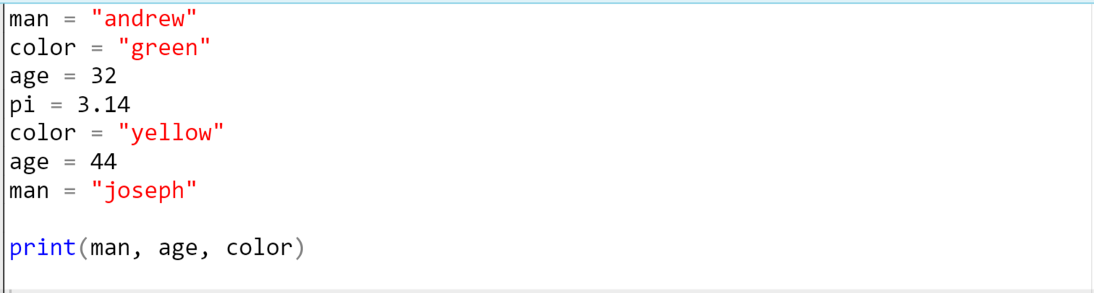
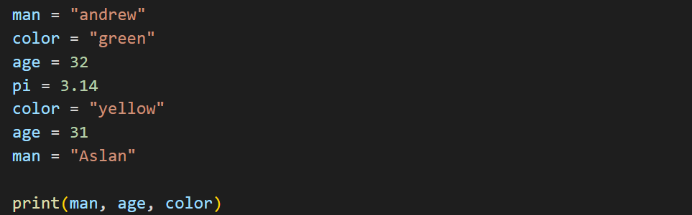
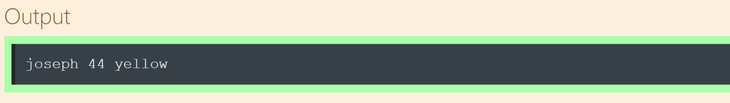
Variables
Pay attention to the value of variables and how they change.
Notes:
let’s jump to the other example. Pay attention to the value of variables and how they change. in this example you should focus on the order of assigning values to the variables. the last one is the updated one. that’s how it works.
man = "andrew"
color = "green"
age = 32
pi = 3.14
color = "yellow"
age = 31
man = "Aslan"
print(man, age, color)

Slide 39
Basic Data Types
Notes:
Hello again my friends. how are you doing today.
how is your course going. are you happy with us.
Now we are stepping on a new stage. This topic is not only very basic but also very important for the rest of this course. i need to emphasize that point. I recommend you to focus on the screen and to my voice carefully.

Slide 40
Introduction to Data Types
str
bool
int
Notes:
so in this part of the session we are going to comprehend basic data types of python.

Slide 41
Introduction to Data Types
Each data has a type.
This type of data defines how you store it in memory and it also describes which process can be applied to it.

Slide 42

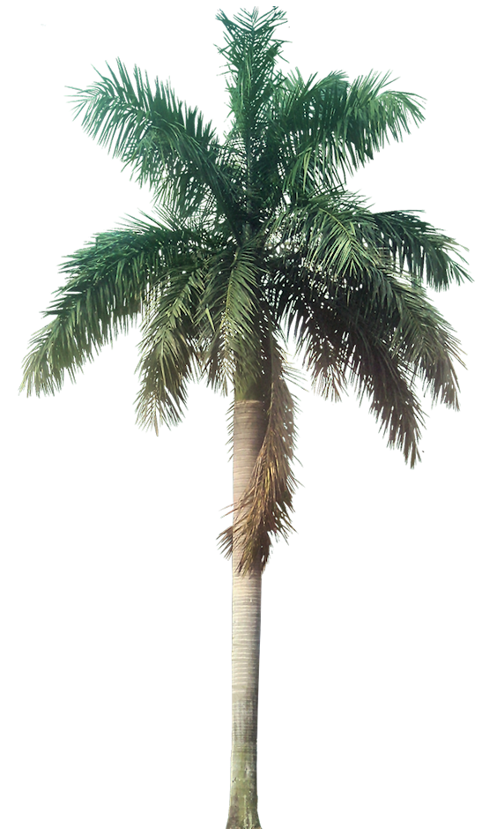
Introduction to Data Types
Some simple data types commonly used in Python.
String,
Integer,
Float,
Boolean.
Notes:
You should have studied these types from your pre-class materials, so let’s take a quick review.
Each data has a type, whether constant or variable. This type of data defines how you store it in memory and it also describes which process can be applied to it.
You can think of types in the real world, bees are bee type and palm trees are palm type. That is, they have certain formats and common features.
the bee has a needle and wings, it makes honey. Palm trees have their own unique leaves, straight body and resistance to thirst. so anyway.

Slide 43
Strings
"2022"
str
"string is the most used type"
"i have 3 lb. of apple"
Notes:
let start learning data types with strings which are the most used type in the Pythonic world.

Slide 44

Strings
If you want to work with any textual characters in your code, you have to work with strings.
my_text = 'being a good person'
print(my_text)
String type is called str.
type(variable)
Notes:
examples of strings :
Strings are identiﬁed as a contiguous set of characters represented in the quotation marks. Python allows for either pair of single or double (or even triple) quotes that we have seen before.
Strings are immutable sequence data type, i.e each time one makes any changes to a string, a completely new string object is created. You will be able to better understand immutability with examples that will continue in the next lessons. so for now, just you need to know that strings are immutable. unchangeable in place. if you want to change strings you have to do something additional things.
If you want to work with any textual characters in your code, you have to work with strings. The string type is called str. Strings are the most common and useful data type in Python.
by the way, you should have been familiar with the “type function” from the pre-class material. what is it used for? we are gonna use type function to display the types of variables or values. we’ll examine it in the next slides today
my_text = 'being a good person'
print(my_text)
type(variable)

Slide 45
Strings
If you want to work with any textual characters in your code, you have to work with strings.
my_text = 'being a good person'
print(my_text)
String type is called str.
being a good person
Strings are identiﬁed as a set of characters represented in the single or double quotes.
Notes:
you see the output of the string type.
so. tell me my friends. tell me. if ask me, being a good person is something challenging, right. do you agree with me? do you think that being a good person is a easy thing in our life. what do you think? ok. let’s hope we are all the good person in our lives.

Slide 46

type(variable)
Write down the followings on your Playground as str type and then print them...
your mail address
632
It's okay!
Notes:
Write down these phrases in string type each on separate lines
How to make them string type in your code?
Yess, just wrapping the characters by quotes, we can make them string type in python.
I am gonna switch to vscode. let’s do it together.

Slide 47
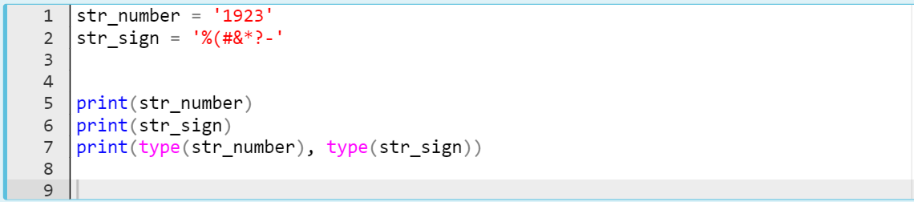
Strings
Let’s do some practices which cover string type.
Notes:
what do you think about these variables. are they string type or not. will there be an error. what do you think.
str_number = "1923"
str_sign = "%(#&*?-"
print(str_number)
print(str_sign)
print(type(str_number), type(str_sign))

Slide 48
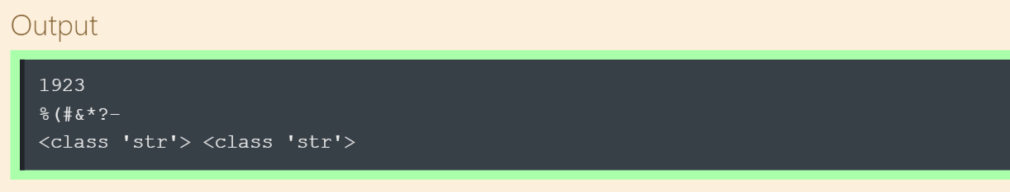
Strings
Let’s do some practices which cover string type.
Notes:
In this exercise, we are going to see that the types of these variables are strings. it’s due to the quotes.
every single character, my friends, enclosed by quotes becomes string type. this is very very important point
str_number = "1923"
str_sign = "%(#&*?-"
print(str_number)
print(str_sign)
print(type(str_number), type(str_sign))

Slide 49
Numeric Types
int
float
Notes:
We continue to review the basic data types of python. You have learned strings and At this time, let’s take a look at how we work with numbers in python codes as well. yes, we are gonna see numeric types

Slide 50
Numeric Types
Three basic numeric types in Python :
Integers
Floats
Complexes
Notes:
For any programmer, in this field, using numbers is the most important issue. You can hardly write a serious program without using numbers, so let's talk about some basic numeric types. here again math came up.
There are three distinct numeric types: signed integer numbers, floating point numbers and complex numbers. in this chapter we are going to focus on two of these. integer and floats. complex type known as imaginary numbers is mostly related to high scientific mathematical and sophisticated engineering fields. so pre-class content is enough for complex types, I will not show you it again in in-class

Slide 51
Numeric Types
Integer types are whole numbers which don’t contain decimal point.
my_integer = 40
negative_num = -18
print(my_integer)
print(negative_num)
Signed integer type is called int.
Notes:
Signed Integer type is called int, they are whole numbers (positive, negative or zero), including no decimal point. For example: 80, -10, 0
So you can see that we have two integer numbers on the screen. one of them is positive and the other is negative
my_integer = 40
negative_num = -18
print(my_integer)
print(negative_num)

Slide 52
Numeric Types
Integer types are whole numbers which don’t contain decimal point.
my_integer = 40
negative_num = -18
print(my_integer)
print(negative_num)
Signed integer type is called int.
40
-18
Notes:
After we run and print them we see the output
my_integer = 40
negative_num = -18
print(my_integer)
print(negative_num)

Slide 53
Numeric Types
Float types stand for real numbers with a decimal point.
my_float = 40.0
negative_float = -18.66
print(my_float)
print(negative_float)
Floating point type is called float.
Notes:
And the other numeric type of python is Floating point type is called float and they stand for real numbers with a decimal point. For example: 71.0, -33.03
my_float = 40.0
negative_float = -18.66
print(my_float)
print(negative_float)

Slide 54
Numeric Types
Float types stand for real numbers with a decimal point.
my_float = 40.0
negative_float = -18.66
print(my_float)
print(negative_float)
Floating point type is called float.
40.0
-18.66
Notes:
my_float = 40.0
negative_float = -18.66
print(my_float)
print(negative_float)

Slide 55


Boolean
Is it
rainy?
True
Notes:
Now we will see one of the most used data types in Python. it is something phenomenon in Pythonic world. Is it rainy? By the way, how is the weather? where you are now?

Slide 56

Boolean
Boolean types’ values are the two constant objects False and True.
True
Boolean type is called bool.
False
Notes:
Boolean types are called bool and their values are the two constant objects True or False. They are used to represent truth values (other values can also be considered false or true). In numeric contexts (for example, when used as the argument to an arithmetic operator), they behave like the integers 1 or 0, respectively. We will see what i am talking about in the next lessons. but for now you have to figure out that boolean types are like exist or non exist, on or off, one or zero. and so on. By the way, Uppercase is important. You have to uppercase the first char of them. T and F
if i need to explain it in other words again.
Bools are important data types that are widely used in Python as they can find usage in every aspect of our daily lives. For example, imagine, whether the TV is turned on or off in your home or if the weather is rainy can be explained easily with bools.
Bools are mostly used in conditional operations. ok i have introduced you to boolean types briefly now and you will be learning the booleans in detail and we will discuss them much in the next lesson.

Slide 57
Type Conversion
int
str
Notes:
…. before starting out this section of this lesson let’s get ready to it by doing a short stretching

Slide 58
Type Conversion
⚠ We can print the types of data using type() function
my_data = 'I am string'
print(type(my_data))
Notes:
my_data = 'I am string'
print(type(my_data))

Slide 59
Type Conversion
⚠ We can print the types of data using type() function
my_data = 'I am string'
print(type(my_data))
<class 'str'>
Notes:
my_data = 'I am string'
print(type(my_data))

Slide 60
Type Conversion
⚠ Type conversion functions.
str() converts to string type
int() converts to signed integer type
float() converts to floating point type
bool() converts to boolean value type
Notes:
We can convert the types of data to each other if the type allows to be converted. There are some functions to convert the types
str() converts to string type
int() converts to signed integer type
float() converts to floating point type
bool() converts to boolean value type

Slide 61



The value of any type in Python can be converted to a str.
True
False

Slide 62
Type Conversion
💡Converting float to str
pi = 3.14
converted_pi = str(pi)
print(converted_pi)
print(type(converted_pi))
Notes:
pi = 3.14
converted_pi = str(pi)
print(converted_pi)
print(type(converted_pi))

Slide 63
Type Conversion
💡Converting float to str
pi = 3.14
converted_pi = str(pi)
print(converted_pi)
print(type(converted_pi))
3.14
<class 'str'>
Notes:
pi = 3.14
converted_pi = str(pi)
print(converted_pi)
print(type(converted_pi))

Slide 64
Type Conversion
💡Converting float to int
pi = 3.14
converted_pi = int(pi)
print(converted_pi)
print(type(converted_pi))
Notes:
This time we convert float to integer type. So, remember how the type function converts float into integer.
pi = 3.14
converted_pi = int(pi)
print(converted_pi)
print(type(converted_pi))

Slide 65
Type Conversion
💡Converting float to int
pi = 3.14
converted_pi = int(pi)
print(converted_pi)
print(type(converted_pi))
3
<class 'int'>
Notes:
You can see that it takes the part before decimal point. it removes decimal part of the number and the integer part of the number remains.
pi = 3.14
converted_pi = int(pi)
print(converted_pi)
print(type(converted_pi))

Slide 66
Type Conversion
💡Converting int to float
no = 3
converted_no = float(no)
print(converted_no)
print(type(converted_no))
Notes:
no = 3
converted_no = float(no)
print(converted_no)
print(type(converted_no))

Slide 67
Type Conversion
💡Converting int to float
no = 3
converted_no = float(no)
print(converted_no)
print(type(converted_no))
3.0
<class 'float'>
Notes:
no = 3
converted_no = float(no)
print(converted_no)
print(type(converted_no))

Slide 68
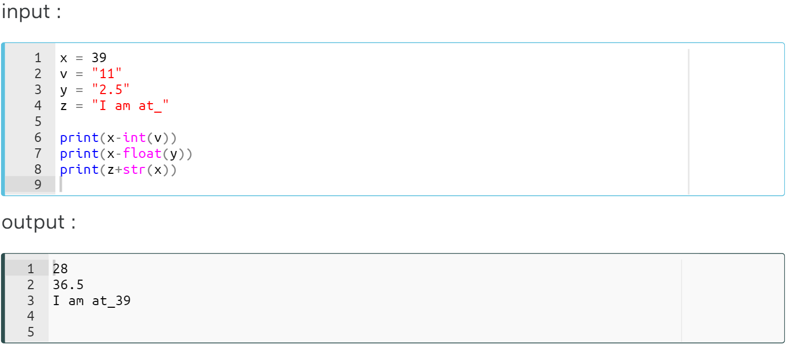
Type Conversion
Notes:
x = 39
v = "11"
y = "2.5"
z = "I am at_"
print(x-int(v))
print(x-float(y))
print(z+str(x))

Slide 69
Type Conversion
x-int("11") = 39-11 = 28
Notes:
…….... if we subtract 11 from 39 then it equals to 28
x = 39
v = "11"
y = "2.5"
z = "I am at_"
print(x-int(v))
print(x-float(y))
print(z+str(x))

Slide 70
Type Conversion
x-int("11") = 39-11 = 28
x-float("2.5") = 39-2.5 = 36.5
Notes:
x = 39
v = "11"
y = "2.5"
z = "I am at_"
print(x-int(v))
print(x-float(y))
print(z+str(x))

Slide 71
Type Conversion
x-int("11") = 39-11 = 28
x-float("2.5") = 39-2.5 = 36.5
z+str(39) = "I am at_" + "39" = I am at_39
Notes:
Yess, I have something for you? Ready?
x = 39
v = "11"
y = "2.5"
z = "I am at_"
print(x-int(v))
print(x-float(y))
print(z+str(x))

Slide 72
Type Conversion, Quiz
💡Without using any Interpreter/IDLE, just try to guess the output.
number_int = 123
number_flt = 1.23
number_new = number_int + number_flt
print("datatype of number_int:", type(number_int))
print("datatype of number_flt:", type(number_flt))
print("Value of number_new:", number_new)
print("datatype of number_new:", type(number_new))
Notes:
number_int = 123
number_flt = 1.23
number_new = number_int + number_flt
print("datatype of number_int:", type(number_int))
print("datatype of number_flt:", type(number_flt))
print("Value of number_new:", number_new)
print("datatype of number_new:", type(number_new))

Slide 73
Type Conversion, Quiz
💡Without using any Interpreter/IDLE, just try to guess the output.
number_int = 123
number_str = "456"
print("Data type of number_int:", type(number_int))
print("Data type of number_str:", type(number_str))
print(number_int + number_str)
Notes:
number_int = 123
number_str = "456"
print("Data type of number_int:", type(number_int))
print("Data type of number_str:", type(number_str))
print(number_int + number_str)

Slide 74
Type Conversion, Quiz
💡Without using any Interpreter/IDLE, just try to guess the output.
number_int = 123
number_str = "456"
print("Data type of number_int:", type(number_int))
print("Data type of number_str before Type Casting:", type(number_str))
number_str = int(number_str)
print("Data type of number_str after Type Casting:", type(number_str))
number_sum = number_int + number_str
print("Sum of number_int and number_str:", number_sum)
print("Data type of the sum:", type(number_sum))
Notes:
number_int = 123
number_str = "456"
print("Data type of number_int:", type(number_int))
print("Data type of number_str before Type Casting:", type(number_str))
number_str = int(number_str)
print("Data type of number_str after Type Casting:", type(number_str))
number_sum = number_int + number_str
print("Sum of number_int and number_str:", number_sum)
print("Data type of the sum:", type(number_sum))

